Slide 1

VW Technology Upgrade </hack>

Slide 2
HRP – Developer Productivity
Platform & Infra – Progress update

Slide 3
Summary
Status / Team | Platform | DW & Infra | TOTAL
Completed | 8 | 1 | 9
Clarified | 2 |  | 2
More Details Required | 2 |  | 2
Road Map | 3 | 1 | 4
TOTAL | 15 | 2 | 17

Slide 4
Completed Features
# | Function | Feature / Enhancement
1 | Platform | Automatic hidden view creation for combo controls
2 | Platform | Automatic task-hidden view mapping in generate service
3 | Platform | Control type definition should be within that screen level
4 | Platform | Provision to define / refine action pattern in design engineering IF RVW allows for Setup UI preference->Action Pattern edits at in Design layout level also (if not used in other activities) it would be better.
5 | Platform | Validation while moving controls/column from main section to hidden section if it already involved in state processing
6 | Platform | Need validation / intimation of update service done already for that generated service
7 | Platform | Need validation when ILBO association not done for a control in manual design
8 | Platform | Need validation when SP is reused across the services and forgot to regenerate other the impacted services
9 | Infra | D-cube we need to refer synonym like tables and views

Slide 5
Clarified Solutions
# | Function | Observation | Clarification Comment
1 | Platform | Like iRule we also need provision to do changes in old State processing design without creating Batch and we need to do automatic generation of state XML in that level itself | Not Feasible - Every change in platform must be trackable with a document (WR/RCN or ECR)- iRule modeling will be planned to enhance with WR support later
2 | Platform | In manual service - need controls as default data items in segment data items section( already BT will be mapped for the controls so better defaulting the dataitem In segment dataitem automatically based on header and ML controls | Not Feasible - For manual service, control BT synonym and segment data item can be different. Defaulting not possible for manual / refine service - However this already handled in pattern-based generation

Slide 6
Moved to TECH Roadmap
# | Function | Observation | Clarification Details
1 | Platform | Need drag and drop of controls to paint the screen | Will be considered in context Platform Modernization
2 | Platform | Sync / Operational issue in Glance - After design while sync to model, control wise showstopper errors will come for which we would need Tech team help to resolve by analyzing glance log files. This is general problem; This sync works for simple screen without any issues. In a recently developed screen, after designed with proper alignment, no changes made after that, alignment has got changed and scrolls started coming in the screen. | Same as #1 - Will be considered in context Platform Modernization
3 | Platform | In Refine service need to show the count of method mapped under that service before & after the update service | Generate Service screen enhancement to display additional information related to service generation mode (Manual, Generated, Refined), No of methods before and after refinement. Additionally apply refinements can be done from Generate service screen itself
4 | Infra | Pivot is Required in D-cube

Slide 7
More details required
# | Function | Feature / Enhancement
1 | Platform | Fire & Forget Integrated service impacts any new DLL changes from Tech team
1 | Infra | While WF parameter definition we need to default all data items and need provision to map required WF Parameter

Slide 8
Automatic hidden view creation for combo controls
Customer – Project level system parameter – AUTO_POPULATE_HDNVIEW_COMBO
Applicable both for header and multi line column
Applicable only for new control / columns specification

Slide 9
Automatic task-hidden view mapping in generate service
Customer – Project level system parameter – AUTO_MAP_HDNVIEW_COMBO
Applicable both for header and multi line column
Applicable only for new service generation

Slide 10
Automatic task-hidden view mapping in generate service
Customer – Project level system parameter – AUTO_MAP_HDNVIEW_COMBO
When combo controls are mapped in task-control mapping, hidden view will be also be automatically mapped.
Applicable both for header and multi combo
Applicable only for pattern-based new service generation

Slide 11
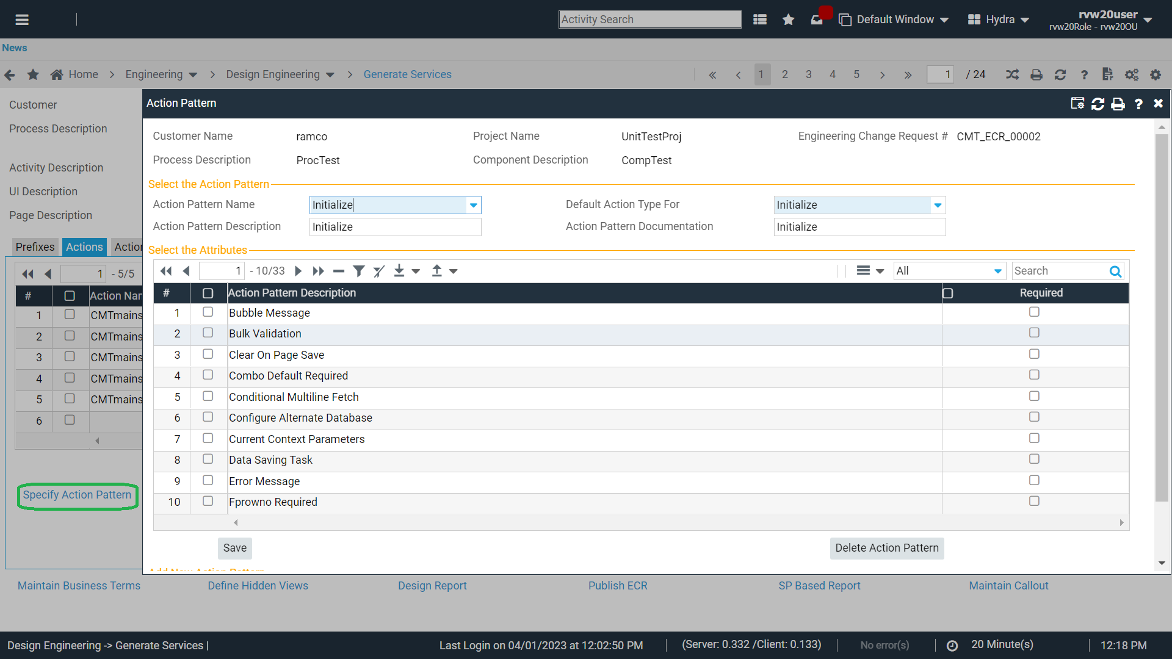
Provision to define / refine action pattern in design engineering.

Slide 12
Generate Service - Refinements
Additional information on service generation mode
Generated
Refined
Manual
For refined service, provision to re-generate service and apply refinements
Information displayed on number of methods before and after refinement

Slide 13
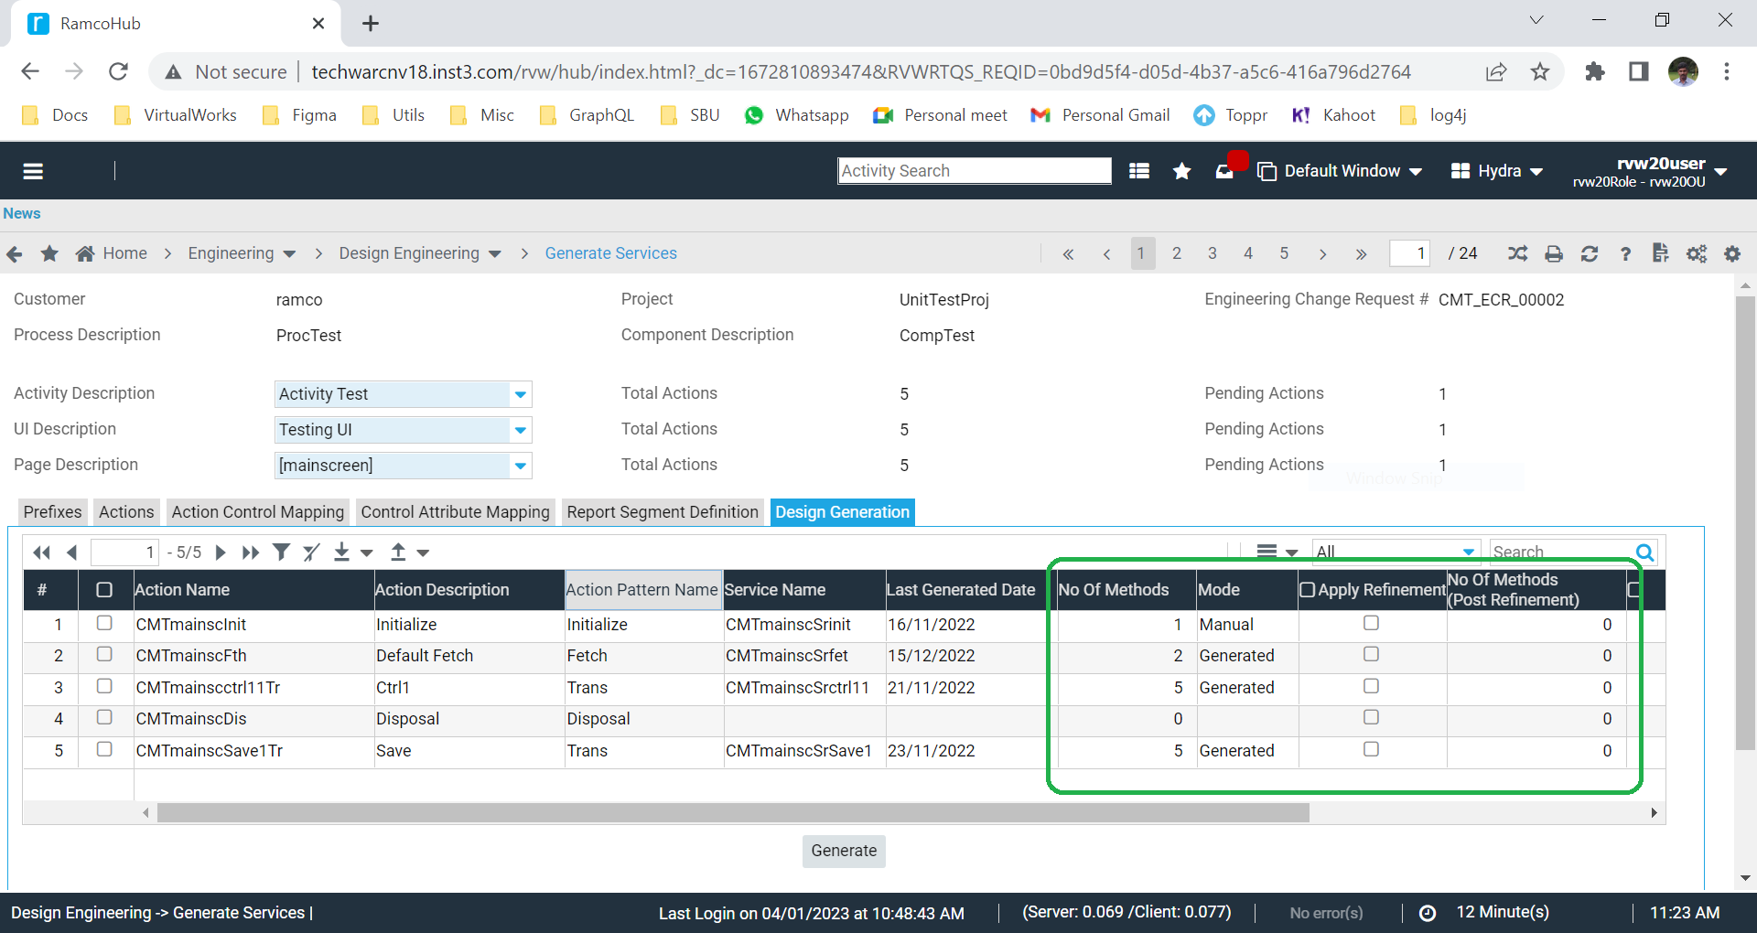
Generate Service - Refinements

Slide 14
Validation
# | Function | Observation | Validation Details
1 | Platform | Validation while moving controls/column from main section to hidden section if it already involved in state processing | Validation added in Specify Layout - when you make Sections/Controls/Columns as hidden, If it is involved in state processing.
2 | Platform | Need validation / intimation of update service done already for that generated service
3 | Platform | Need validation when ILBO association not done for a control in manual design | Validation added in Publish ECR - if a control is not mapped to any of the services/Publications/Control-Attribute mapping.
4 | Platform | Need validation when SP is reused across the services and forgot to regenerate other the impacted services | Validation added in Publish ECR - if a service is regenerated and their SP is reused in other services(not regenerated)

